Slide 1
A Tutorial on Mobile Visualization
Benjamin Watson
North Carolina State University
Vidya Setlur
Tableau Research

Slide 2
Agenda
Part I
Introduction
Motivation
Guidelines and constraints
Part II
Visualization in the field
Applications
Part III
Research
Open problems
Discussion
Wrap-Up

Slide 3
Agenda
Part I
Introduction
Motivation
Guidelines and constraints
Part II
Visualization in the field
Applications
Part III
Research
Open problems
Discussion
Wrap-Up

Slide 4
Intro – Ben Watson

Slide 5

Vidya Setlur
Background in computer graphics, mobile and natural language processing.
PhD from Northwestern University in 2005
Currently at Tableau Research
Previously worked at Nokia Research for 7 years

Slide 6
Agenda
Part I
Introduction
Motivation
Guidelines and constraints
Part II
Visualization in the field
Applications
Part III
Research
Open problems
Discussion
Wrap-Up

Slide 7
What is Information Visualization?
“Transformation of the symbolic into the geometric” - McCormick et al., 1987
“... finding the artificial memory that best supports our natural means of perception.''
- Bertin, 1983
The depiction of information using spatial or graphical representations, to facilitate comparison, pattern recognition, change detection, and other cognitive skills by making use of the visual system.

Slide 8
Information Visualization
Problem:
HUGE Datasets: How to understand them?
Solution
Take better advantage of human perceptual system
Convert information into a graphical representation.
Issues
How to convert abstract information into graphical form?
Do visualizations do a better job than other methods?

Slide 9
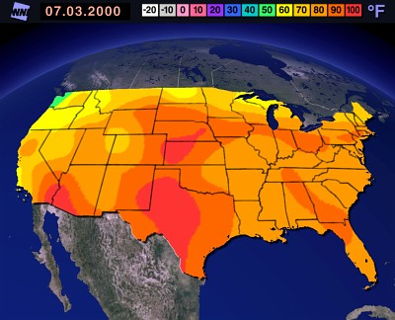
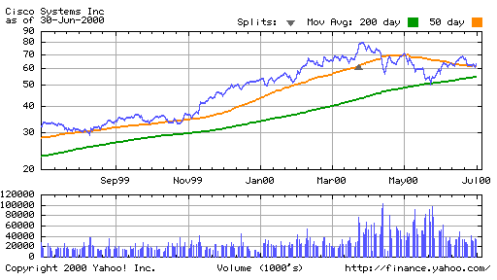
Visualization Success Stories

Slide 10
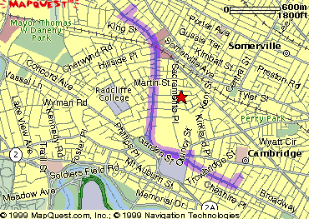
The Power of Visualization

Slide 11
Visualization Success Story
Mystery: what is causing a cholera epidemic in London in 1854?

Slide 12
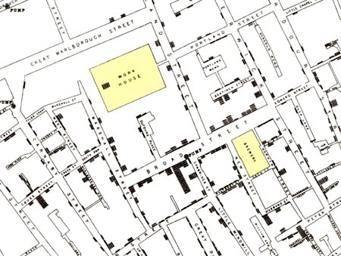
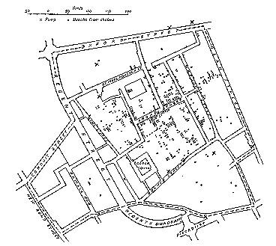
Visualization Success Story
Illustration of John Snow’s deduction that a cholera epidemic
was caused by a bad water pump, circa 1854.
Horizontal lines indicate location of deaths.
From Visual Explanations by Edward Tufte, Graphics Press, 1997

Slide 13
Agenda
Part I
Introduction
Motivation
Guidelines and constraints
Part II
Visualization in the field
Applications
Part III
Research
Open problems
Discussion
Wrap-Up

Slide 14
Goals of Information Visualization
Make data coherent
Present information from various viewpoints
Present information at several levels of detail
Support visual comparisons
Tell stories about the data

Slide 15
Why Visualization?
People are good at
scanning
recognizing
remembering imagery
Graphical elements facilitate comparisons via
length
shape
orientation
texture
Animation shows changes across time
Color helps make distinctions
Aesthetics make the visual analysis process appealing

Slide 16
Visual Principles
Types of Graphs
Pre-attentive Properties
Visual Cues
Visual Illusions
Tufte’s notions
Graphical Excellence
Data-Ink Ratio Maximization
How to Lie with Visualization

Slide 17
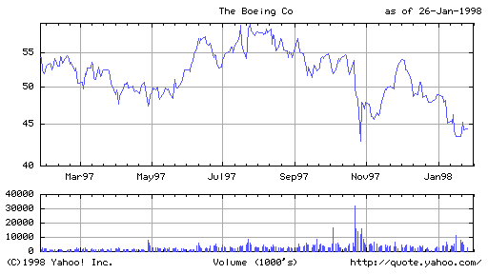
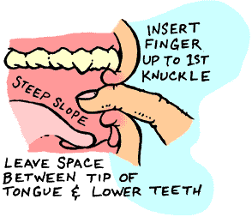
Types of Symbolic Displays (Kosslyn 89)
Graphs
Charts
Maps
Diagrams

Slide 18
Types of Symbolic Displays
Graphs
at least two scales required
values associated by a symmetric “paired with” relation
Examples: scatter-plot, bar-chart, layer-graph

Slide 19
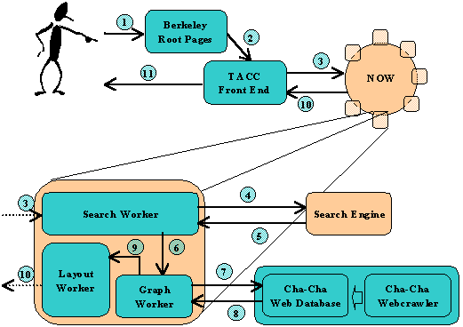
Types of Symbolic Displays
Charts
discrete relations among discrete entities
structure relates entities to one another
lines and relative position serve as links
Examples:
family tree
flow chart
network diagram

Slide 20
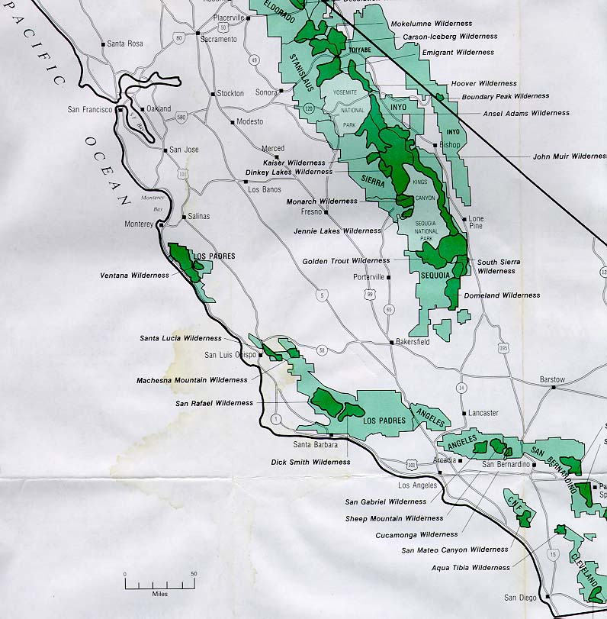
Types of Symbolic Displays
Maps
internal relations determined (in part) by the spatial relations of what is pictured
labels paired with locations
Examples:
map of census data topographic maps
From www.thehighsierra.com

Slide 21
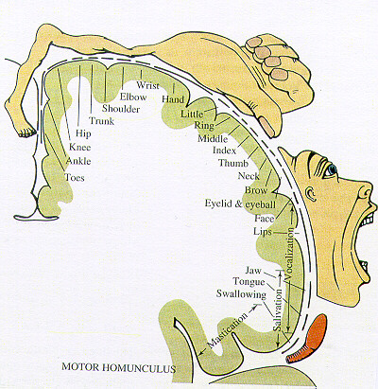
Types of Symbolic Displays
Diagrams
schematic pictures of objects or entities
parts are symbolic (unlike photographs)
how-to illustrations
figures in a manual
From Glietman, Henry. Psychology. W.W. Norton and Company, Inc. New York, 1995

Slide 22
Anatomy of a Graph (Kosslyn 89)
Framework
sets the stage
kinds of measurements, scale, ...
Content
marks
point symbols, lines, areas, bars, …
Labels
title, axes, tic marks, ...

Slide 23
Basic Types of Data
Nominal (qualitative)
(no inherent order)
city names, types of diseases, ...
Ordinal (qualitative)
(ordered, but not at measurable intervals)
first, second, third, …
cold, warm, hot
Interval (quantitative)
list of integers or reals

Slide 24
Common Graph Types
# of accesses
# of accesses
length of page
URL
length of access
length of access
45
url 1
url 2
url 3
url 4
url 5
url 6
url 7
40
35
# of accesses
30
length of access
25
20
15
10
5
0
short
long
very
long
medium
days
# of accesses
length of page

Slide 25
When to use which type?
Line graph
x-axis requires quantitative variable
Variables have contiguous values
familiar/conventional ordering among ordinals
Bar graph
comparison of relative point values
Scatter plot
convey overall impression of relationship between two variables
Pie Chart?
Emphasizing differences in proportion among a few numbers

Slide 26
Visual Properties
Preattentive Processing
Accuracy of Interpretation of Visual Properties
Illusions and the Relation to Graphical Integrity

Slide 27
Pre-attentive Processing
< 200 - 250ms qualifies as pre-attentive
eye movements take at least 200ms
yet certain processing can be done very quickly, implying low-level processing in parallel
If a decision takes a fixed amount of time regardless of the number of distractors, it is considered to be preattentive.

Slide 28
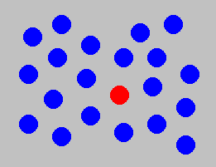
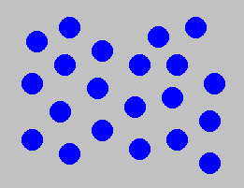
Example: Color Selection
Notes:
Viewer can rapidly and accurately determine
whether the target (red circle) is present or absent.
Difference detected in color.

Slide 29
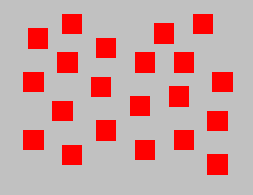
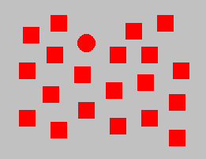
Example: Shape Selection
Notes:
Viewer can rapidly and accurately determine
whether the target (red circle) is present or absent.
Difference detected in form (curvature)

Slide 30
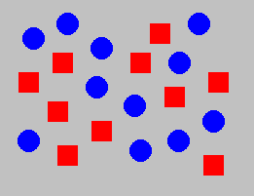
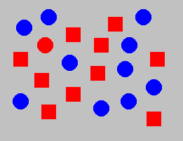
Example: Conjunction of Features
Notes:
Viewer cannot rapidly and accurately determine
whether the target (red circle) is present or absent when
target has two or more features, each of which are
present in the distractors. Viewer must search sequentially.

Slide 31
Gestalt Properties
Gestalt: form or configuration
Idea: forms or patterns transcend the stimuli used to create them.

Slide 32
Gestalt Laws
Law of Proximity
Stimulus elements that are close together will be perceived as a group
Law of Similarity
like the preattentive processing examples
Law of Common Fate
like preattentive motion property
move a subset of objects among similar ones and they will be perceived as a group

Slide 33
Which Properties are Appropriate for Which Information Types?

Slide 34
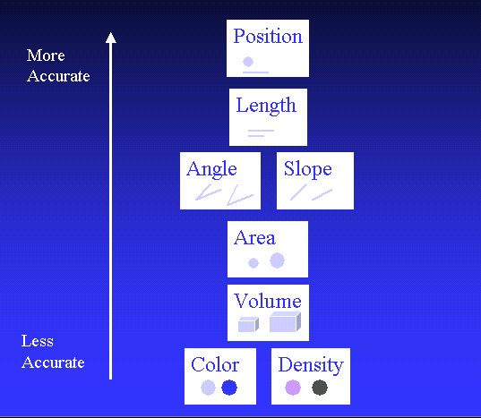
Accuracy Ranking of Quantitative Perceptual Tasks Estimated; only pairwise comparisons have been validated (Mackinlay 88 from Cleveland & McGill)

Slide 35
In Summary
Use graphics appropriately
Don’t lie with graphics
Don’t conflate area with other information
Make it interactive (feedback)
Match mental models

Slide 36
Howard Wainer How to Display Data Badly (Video) http://www.dartmouth.edu/~chance/ChanceLecture/AudioVideo.html

Slide 37
Agenda
Part I
Introduction
Motivation
Guidelines and constraints
Part II
Visualization in the field
Applications
Part III
Research
Open problems
Discussion
Wrap-Up

Slide 38

Trends in Mobile Computing

Slide 39

Mobile Visualization
Notes:
M-commerce will overtake e-commerce
The global mobile-payment race will enter its final stretch.
The screen-agnostic experience will grow.
The market will push for more privacy.
Technologies will settle.
Mobile will become “a target”.
IoT will expand its footprint.
The battle for the wearables market is just getting started.
Competition for the connected home and vehicle will intensify.

Slide 40








State of the Union
Notes:
Yellowfin BI: An Aussie company that is taking over EMEA. USP: integrated collaboration. Offers offline support.
Qlik Sense: Completely built using HTML5. Is designed for touch/gestures, designed for different screen sizes
Domo: Very heavily service-dependent, but their solution is very well-rounded. They are a serious competitor for us!
Salesforce Wave: Enterprise app. Offers dashboard authoring.
Microsoft Power BI: Only iOS, no WP! Very similar to Ackbar (hybrid app, connects to a server). Permits dashboard authoring, which we do not
RoamBI: Has 3 applications: Analytics (Ackbar compete), Flow (Flipboard-like app) and Blink (Elastic compete).
Microstrategy: Most advanced mobile BI application in the market. Offers the building blocks to build a mobile experience ground up. Enables automatic updates.
Birst:

Slide 41
‘Internet of Things’

Slide 42
(show other visual examples)
Stock
Weather
Analysis on the go
Web browsing
fitness

Slide 43
Exercise
Download and install the following apps:

Slide 44
Agenda
Part I
Introduction
Motivation
Guidelines and constraints
Part II
Visualization in the field
Applications
Part III
Research
Open problems
Discussion
Wrap-Up

Slide 45
Semantic resizing

Slide 46
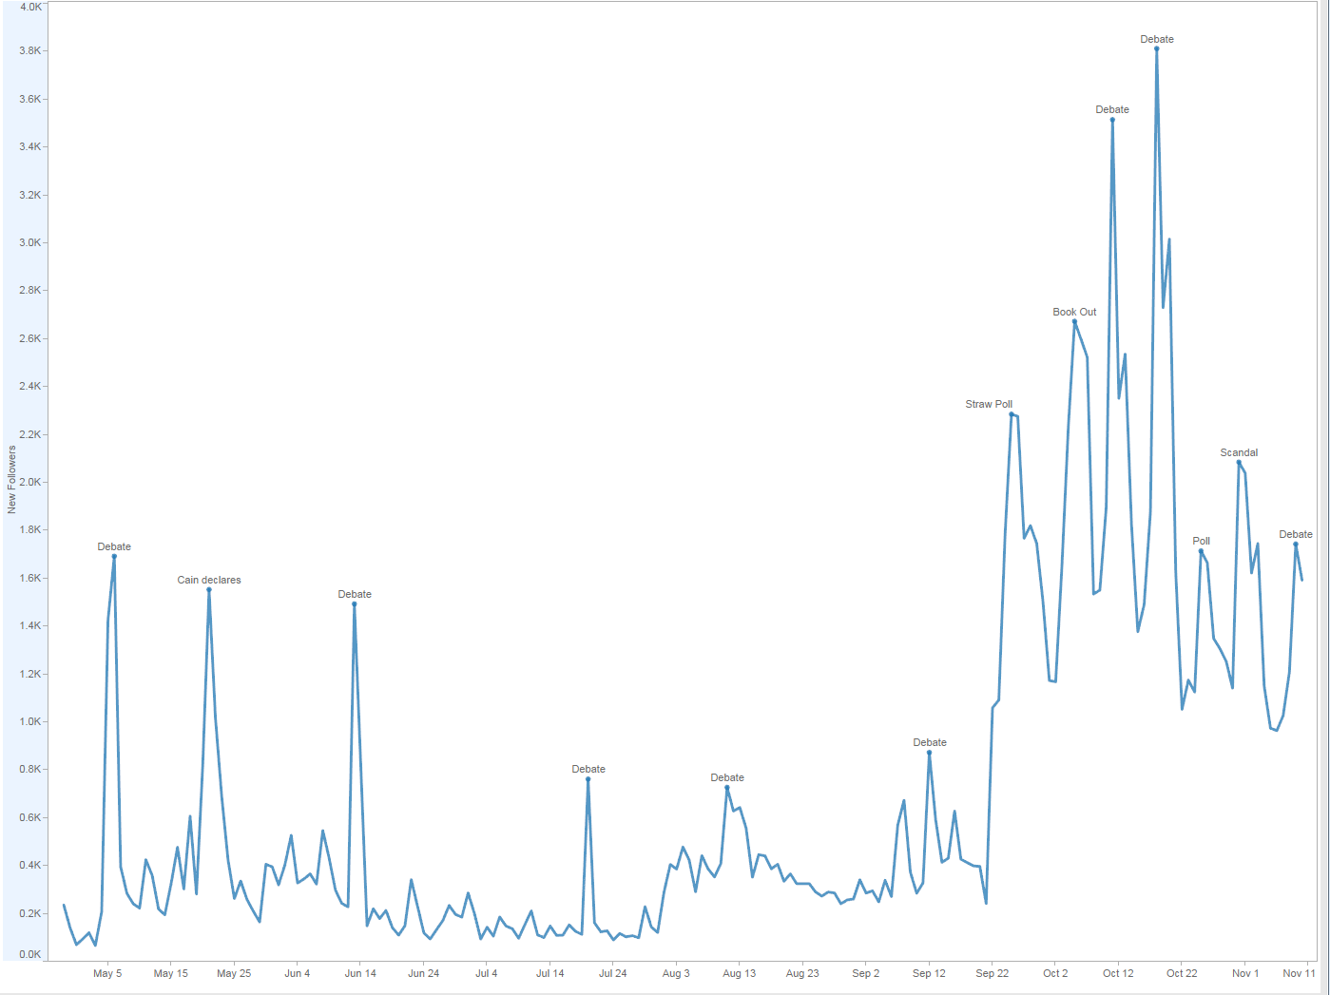
Notes:
In Tableau, there are currently no simplification or elimination algorithms in place.
We dont ever do anything to simplify what we’re drawing. A scatter plot with a million marks all in the same place? Draw them all. A line with a million vertices all in the same place? Render ’em.
Labeling uses simulated annealing and removes labels with overlap

Slide 47
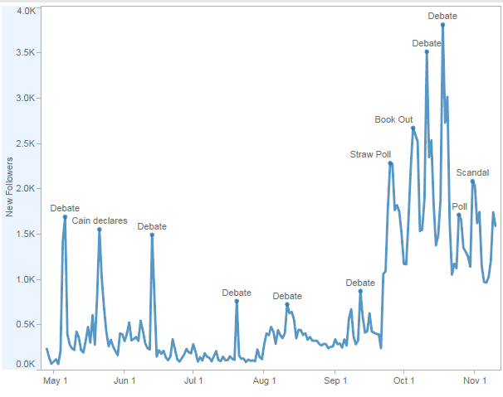
Notes:
In Tableau, there are currently no simplification or elimination algorithms in place.
We dont ever do anything to simplify what we’re drawing. A scatter plot with a million marks all in the same place? Draw them all. A line with a million vertices all in the same place? Render ’em.
Labeling uses simulated annealing and removes labels with overlap

Slide 48
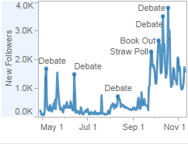
Notes:
In Tableau, there are currently no simplification or elimination algorithms in place.
We dont ever do anything to simplify what we’re drawing. A scatter plot with a million marks all in the same place? Draw them all. A line with a million vertices all in the same place? Render ’em.
Labeling uses simulated annealing and removes labels with overlap

Slide 49
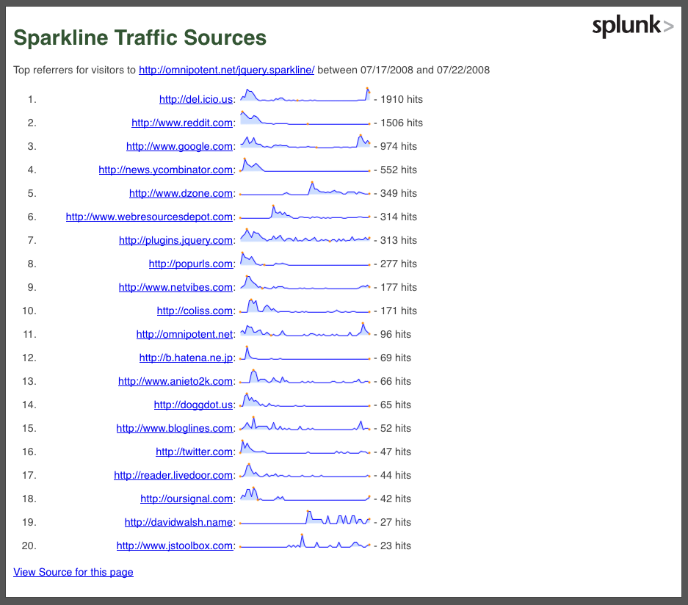
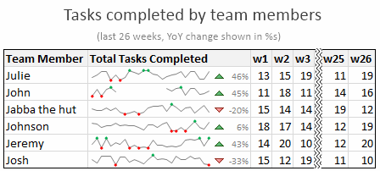
Notes:
Sparklines are among the earliest microcharts, initially created by Edward Tufte. They are the equivalent of line graphs, but without the labels and axes.
These make it very easy to compare trends within a series. However, comparing across series may not be easy. In fact, it would not be possible at all unless the sparklines are drawn to scale. They are particularly effective in representing growth or decline trends in a compact fashion.

Slide 50
How can we render visualizations effectively at different sizes?
Notes:
Visualization resizing is critical and required for the current use of visualizations (e.g., dashboards, mobile devices,
Too many variation to deal with resizing visualizations. (e.g., display resolution/size/application window width/aspect ratio/etc.)
Impossible for a visualization designer to consider every possible combination of these variation.
Needs to support a smarter way to adapt and represent a visualization based upon different scales.

Slide 51
Cartographic Generalization
“Process of selecting and representing information of a map in a way that adapts to the scale of the display medium of the map.”
Ref: http://wiki.gis.com/wiki/index.php/Cartographic_generalization,
How Maps Work, Alan Maceachren

Slide 52
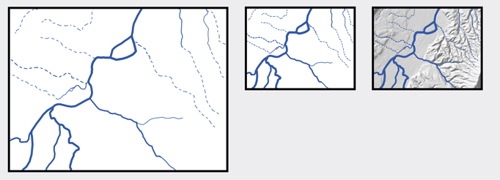

Addition
Elimination

Slide 53

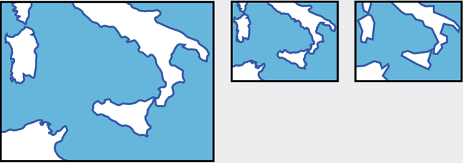
Exaggeration
Simplification

Slide 54
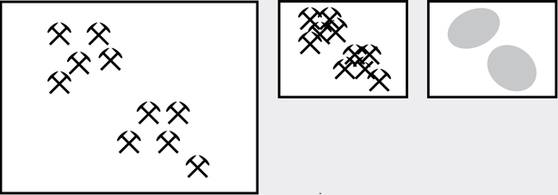
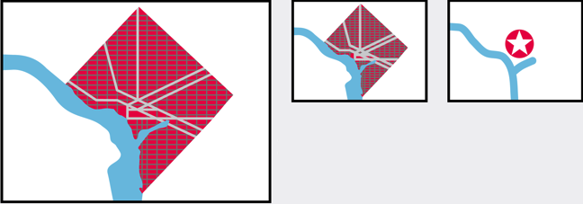

Aggregation (increased dimensionality)
Collapse (decreased dimensionality)
Merge (equal dimensionality)

Slide 55
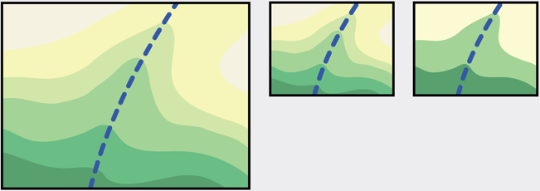
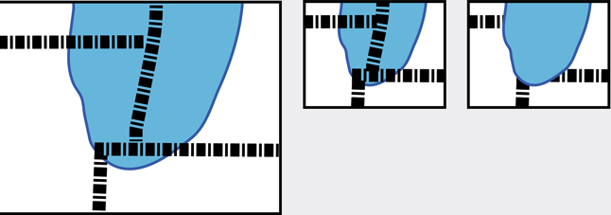
Reclassification
Reordering

Slide 56
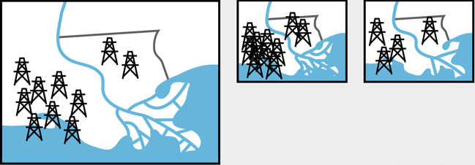
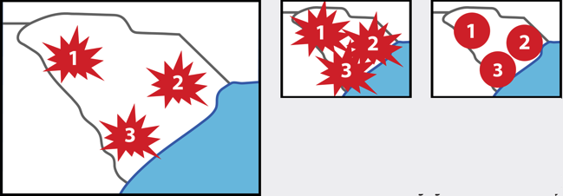
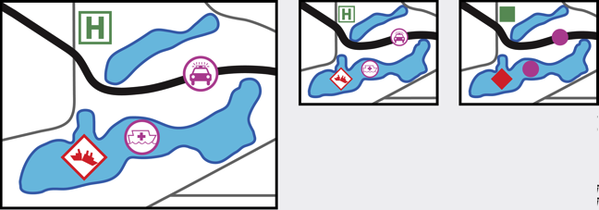

Typification
Shape adjustment
Iconicity adjustment
Color adjustment
Notes:
Symbol operators

Slide 57
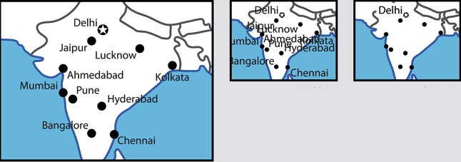
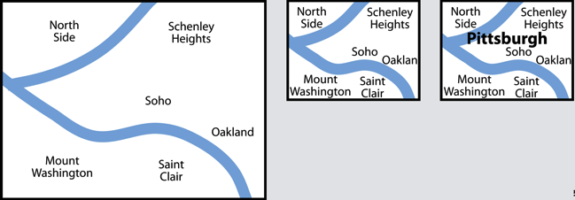
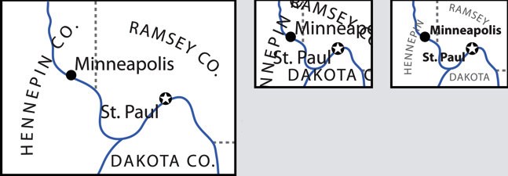
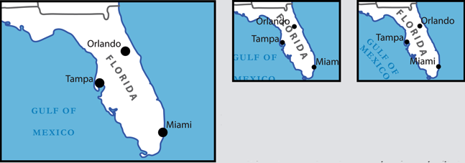
Label Elimination
Label Insertion
Label Appearance
Label Positioning
Notes:
Label operators

Slide 58
Generalization principles
Take into account the data semantics.
Emphasize the most important elements while still representing the view in the most faithful and recognizable way.
The level of detail and importance in what is remaining on the view must outweigh the insignificance of items that were deemphasized.

Slide 59
Overview + detail

Slide 60
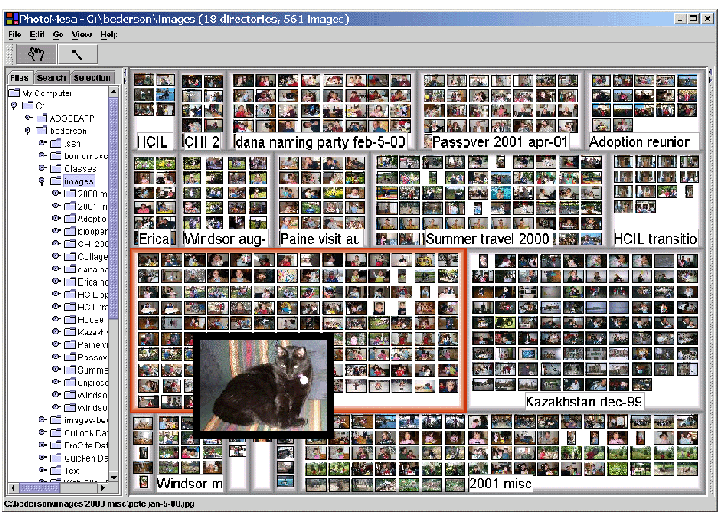
Overview + Detail
Benjamin B. Bederson: PhotoMesa: a zoomable image browser using quantum treemaps and bubblemaps. UIST 2001.

Slide 61
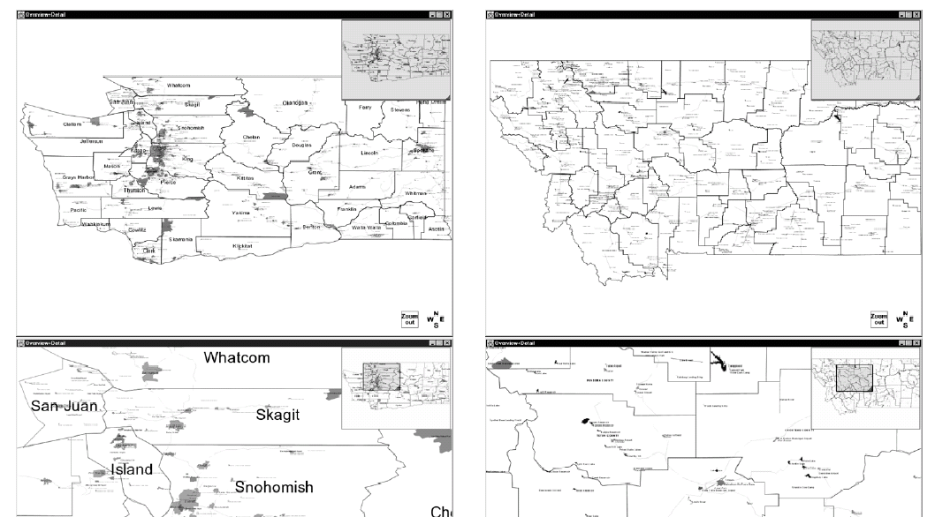
Overview + Detail
K. Hornbaek et al., Navigation patterns and Usability of Zoomable User Interfaces with and without an Overview, ACM TOCHI, 9(4), December 2002.
Notes:
K. Hornbaek et al., Navigation patterns and Usability of Zoomable User Interfaces with and without an Overview, ACM TOCHI, 9(4), December 2002.
A study on integrating Overview + Detail on a Map search task
Incorporating panning & zooming as well.
They note that panning & zooming does not do well in most studies.
Results seem to be
Subjectively, users prefer to have a linked overview
But they aren’t necessarily faster or more effective using it
Well-constructed representation of the underlying data may be more important.
More research needed as each study seems to turn up different results, sensitive to underlying test set.

Slide 62
Responsive vizes and dashboards

Slide 63
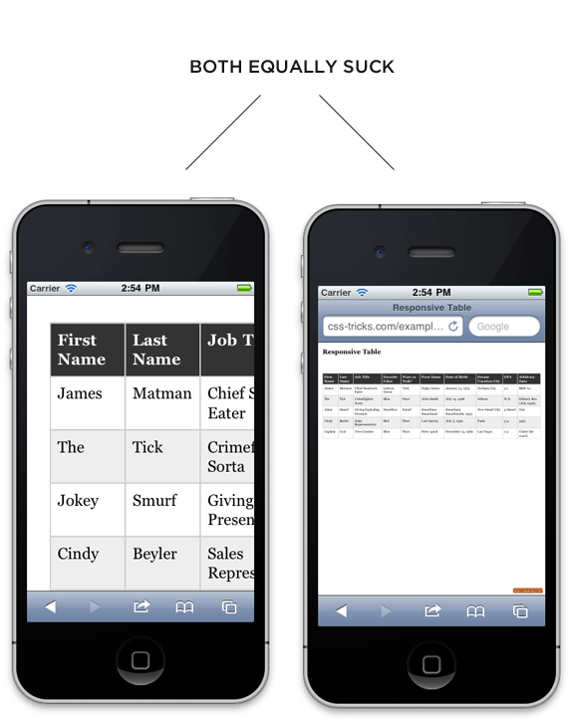
Notes:
So both of these are not optimal. In the first, you lose context, involves scrolling horizontally and vertically.
Second one, can’t read.

Slide 64
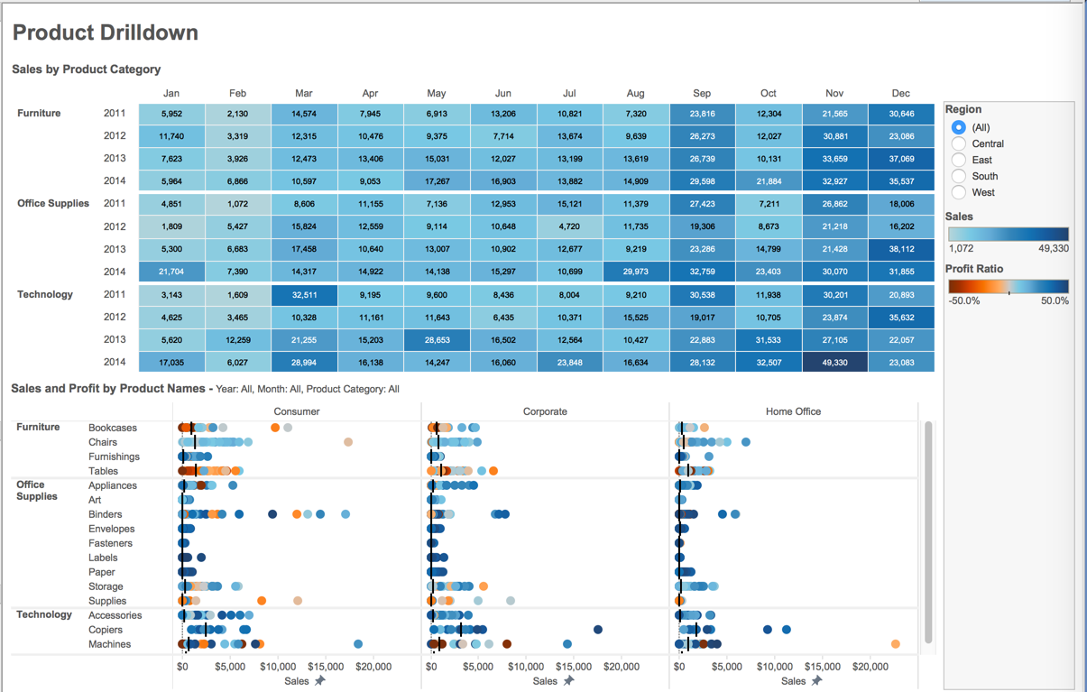
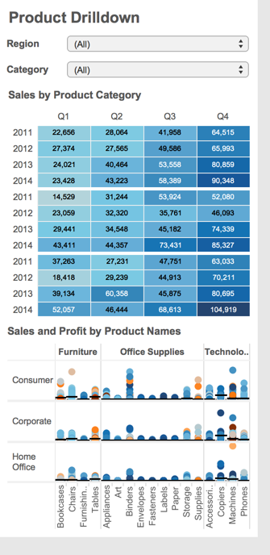
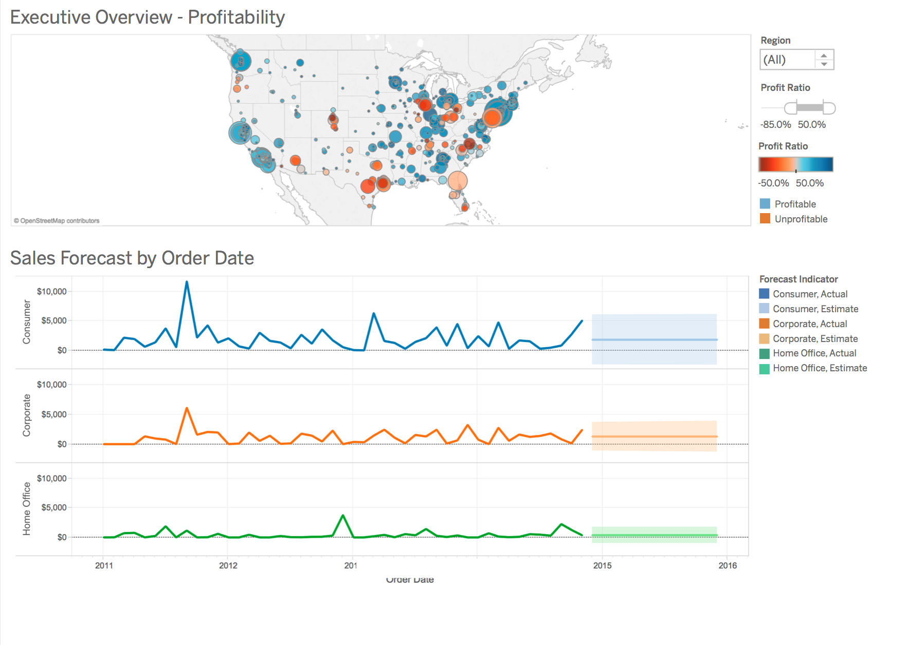
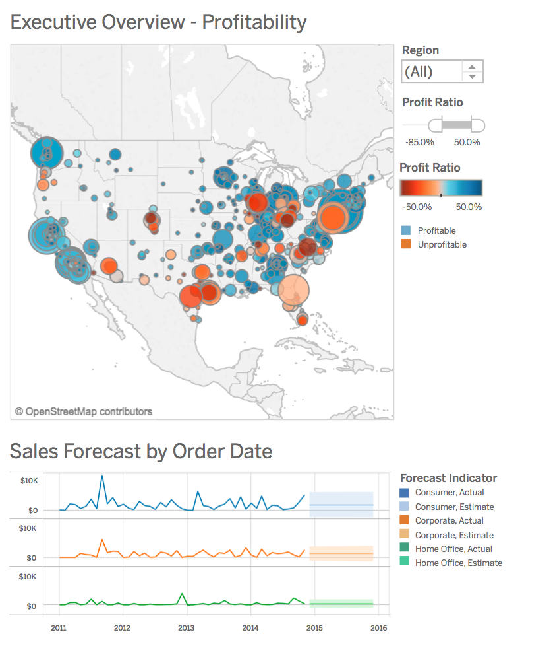
Notes:
As part of the hackathon, we explored dashboards, data tables and various ways of showing data when the size gets too small.
Filters to view one category or a subset of categories at a time.
Data aggregation, fonts and so forth.
At the hackathon faire, we got sufficient interest with data tables and it seemed like an easier problem to tackle at least for now since it does not involve graphics.

Slide 65
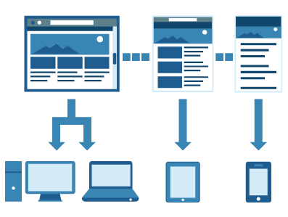
Motivation: Responsive Websites
Making and Breaking the Grid – Timothy Samara/
Notes:
What is it? A website layout that responds to a users’ device automatically.
- Adaptive, Responsive and Mobile are somewhat interchangeable ways of talking about the same thing. (In general, they all intend to make it so that people viewing your site on a smart phone or tablet can navigate and read content without doing an excessive amount of pinching and zooming...that the experience is optimized for their device.)

Slide 66
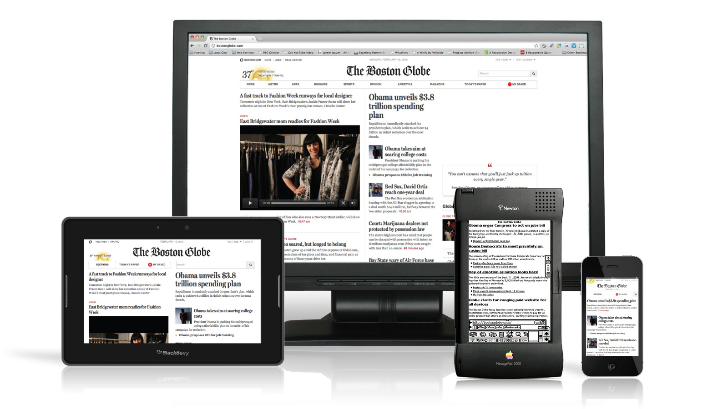
Responsive Websites
Developing a website that allows the layout to change along with a user’s computer screen resolution.
Notes:
Uses CSS (style sheets) to display the content in the appropriate order, font, etc., depending upon device.

Slide 67
Aspects of Responsiveness
Layout - target sizes (desktop, tablet, phone)
Data Semantics
Interaction

Slide 68
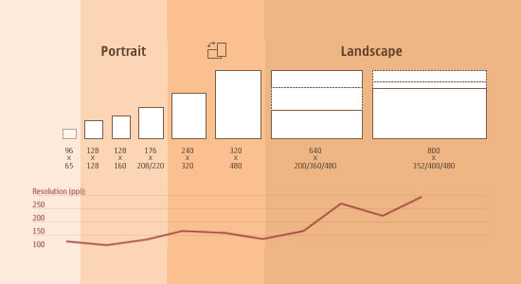
Adjusting Screen Resolution
Morten Hjerde et al. – Mobile Screen Size Trends, 2008
Notes:
With more devices come varying screen resolutions, definitions and orientations. New devices with new screen sizes are being developed every day, and each of these devices may be able to handle variations in size, functionality and even color. Some are in landscape, others in portrait, still others even completely square. As we know from the rising popularity of the iPhone, iPad and advanced smartphones, many new devices are able to switch from portrait to landscape at the user’s whim. How is one to design for these situations?
Yes, it is possible to group them into major categories, design for each of them, and make each design as flexible as necessary. But that can be overwhelming, and who knows what the usage figures will be in five years?

Slide 69
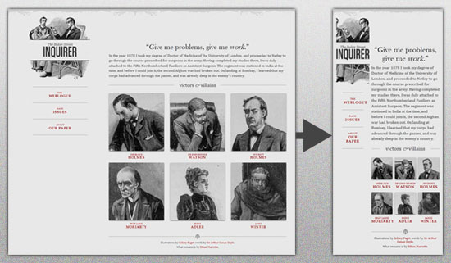
Flexible Everything
Designing Multi-Device Experiences: An Ecosystem Approach to User Experiences across Devices - Michal Levin
Notes:
A few years ago, when flexible layouts were almost a “luxury” for websites, the only things that were flexible in a design were the layout columns (structural elements) and the text. Images could easily break layouts, and even flexible structural elements broke a layout’s form when pushed enough. Flexible designs weren’t really that flexible; they could give or take a few hundred pixels, but they often couldn’t adjust from a large computer screen to a netbook.
Now we can make things more flexible. Images can be automatically adjusted, and we have workarounds so that layouts never break (although they may become squished and illegible in the process). While it’s not a complete fix, the solution gives us far more options. It’s perfect for devices that switch from portrait orientation to landscape in an instant or for when users switch from a large computer screen to an iPad.

Slide 70
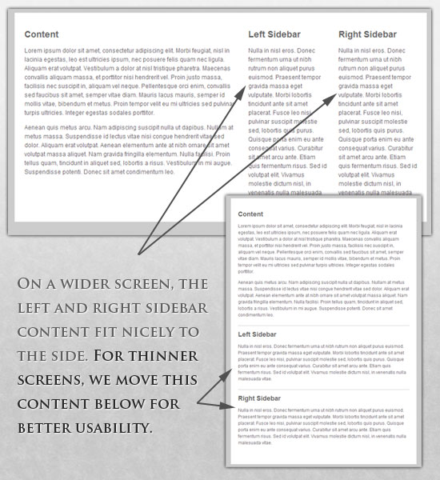
Custom Style Sheets
Notes:
For extreme size changes, we may want to change the layout altogether, either through a separate style sheet or, more efficiently, through a CSS media query. This does not have to be troublesome; most of the styles can remain the same, while specific style sheets can inherit these styles and move elements around with floats, widths, heights and so on.
For example, we could have one main style sheet (which would also be the default) that would define all of the main structural elements, such as #wrapper, #content, #sidebar, #nav, along with colors, backgrounds and typography. Default flexible widths and floats could also be defined.
If a style sheet made the layout too narrow, short, wide or tall, we could then detect that and switch to a new style sheet. This new child style sheet would adopt everything from the default style sheet and then just redefine the layout’s structure.

Slide 71
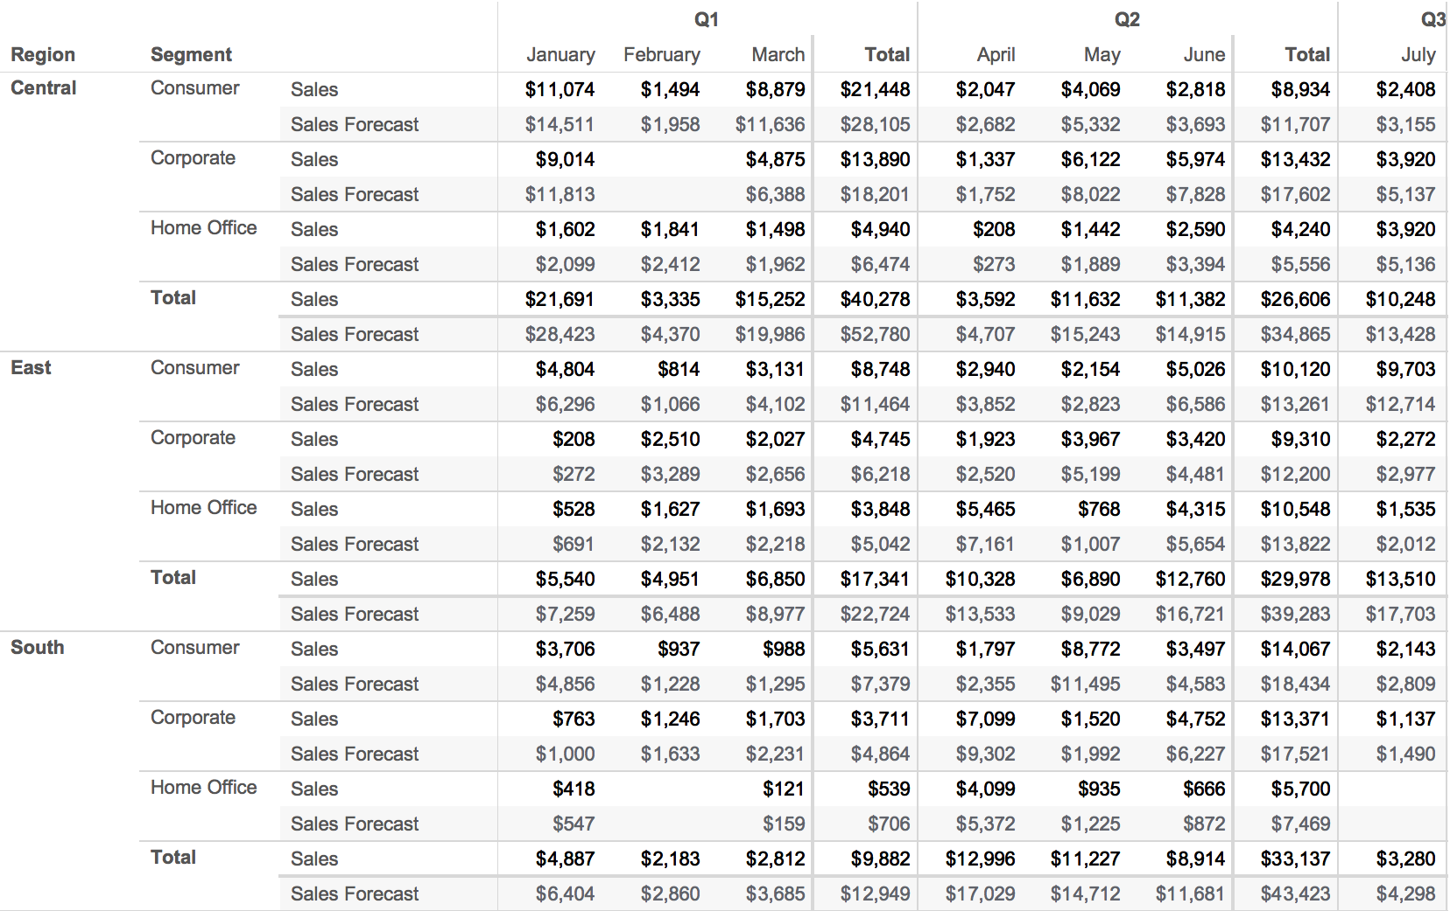
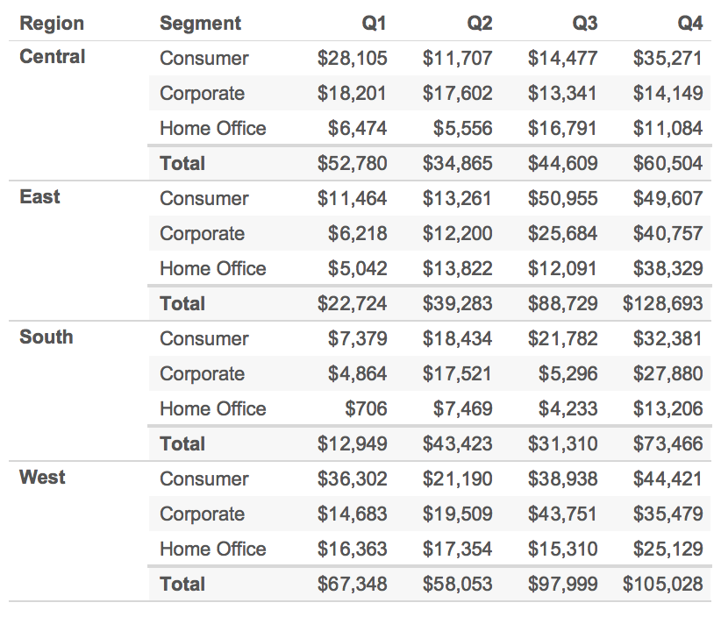
Notes:
Amanda’s hackathon

Slide 72
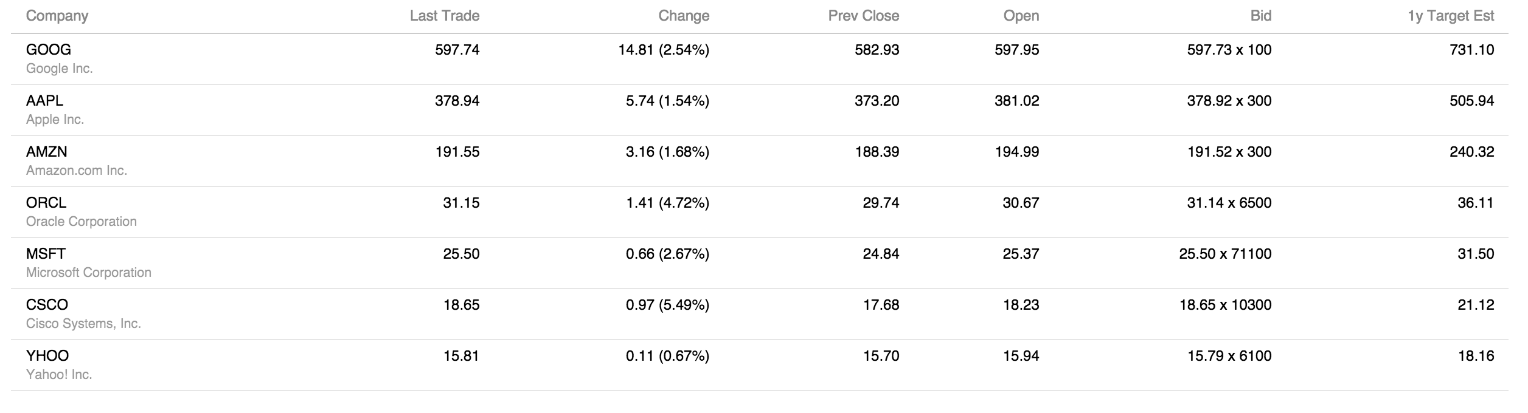

Selectively Displaying Data
Notes:
The number of columns displayed in the table below depends on the available screen space, by default; a smartphone will display 2 columns, for example, while an expanded desktop browser displays the full set. This is accomplished by assigning semantic classes to the column headings that indicate which data values take precedence (essential vs optional), in combination with media queries to display them at different screen widths (a.k.a., responsive design).
We added a bit of JavaScript logic so you can control which data is displayed by checking column names in the "Display" menu on the right. Once an option is checked, the associated data will persist and display at all screen widths until the option is unchecked.
You can also set a column to always persist by assigning a class in the markup, in which case it has no menu option. Here, the "Company" column is persistent.

Slide 73


Changing Orientation

Slide 74


Table Cards

Slide 75

Collapsing detail

Slide 76

Collapsing detail

Slide 77

Responsive Typography
Notes:
Different fonts with the same size occupy different amounts of pixels on the screen

Slide 78

iOS: Dynamic Type
Notes:
The Dynamic lets developers specify which fonts to use at each font size. This allows them to select heavier weights when type is small, for example. Compare this to the example on the left which demonstrates a simple decrease in size of the headline weight only, and the one on the right which shows just the text font getting larger.

Slide 79

Mobile Context + Focus
Location, Time, Alerts in changes in data

Slide 80

Mobile Context + Focus
Location, Time, Alerts in changes in data

Slide 81
Document browsing and visual summaries

Slide 82
Why Visualize Documents?
To help with Information Retrieval
Provide an overview of a collection
Show a user what aspects of their interests are present in a collection
Help user understand why documents retrieved as a result of a query

Slide 83
Why Text is Tough
Text is not pre-attentive
Text consists of abstract concepts
Text represents similar concepts in many different ways
Text has very high dimensionality

Slide 84
Why Text is Easy
Text is highly redundant
When you have lots of it
Pretty much any simple technique can pull out phrases that seem to characterize a document
Instant summary:
Extract the most frequent words from a text
Remove the most common English words
People are very good at attributing meaning to lists of otherwise unrelated words

Slide 85
Characteristics of Visual Summaries
Memorable
Semantic and Visual Depiction
Advertising most interesting part of the viz.
Semantically related to blog or underlying story

Slide 86

Flamenco

Slide 87

Flamenco

Slide 88




Summary Thumbnails – Lam and Baudisch.
Enhanced Thumbnails - Woodruff et al.
Visual Snippets – Teevan et al.

Slide 89



Visual IDS - Lewis et al.
OS X Icon Style Guide
Semanticons- Setlur et al.

Slide 90


Slide 91


Slide 92



Slide 93



Slide 94


Notes:
Before snapping

Slide 95



Slide 96



Slide 97



Slide 98
Agenda
Part I
Introduction
Motivation
Guidelines and constraints
Part II
Visualization in the field
Applications
Part III
Research
Open problems
Discussion
Wrap-Up

Slide 99
Agenda
Part I
Introduction
Motivation
Guidelines and constraints
Part II
Visualization in the field
Applications
Part III
Research
Open problems
Discussion
Wrap-Up

Slide 100
Revisiting the Apps

Slide 101
Agenda
Part I
Introduction
Motivation
Guidelines and constraints
Part II
Visualization in the field
Applications
Part III
Research
Open problems
Discussion
Wrap-Up

Slide 102
For more information
(add references)

Slide 103
Thank you!

